Slide 1
Finding Fast Matrix Multiplication with Symmetry
Jacob Adams

Slide 2
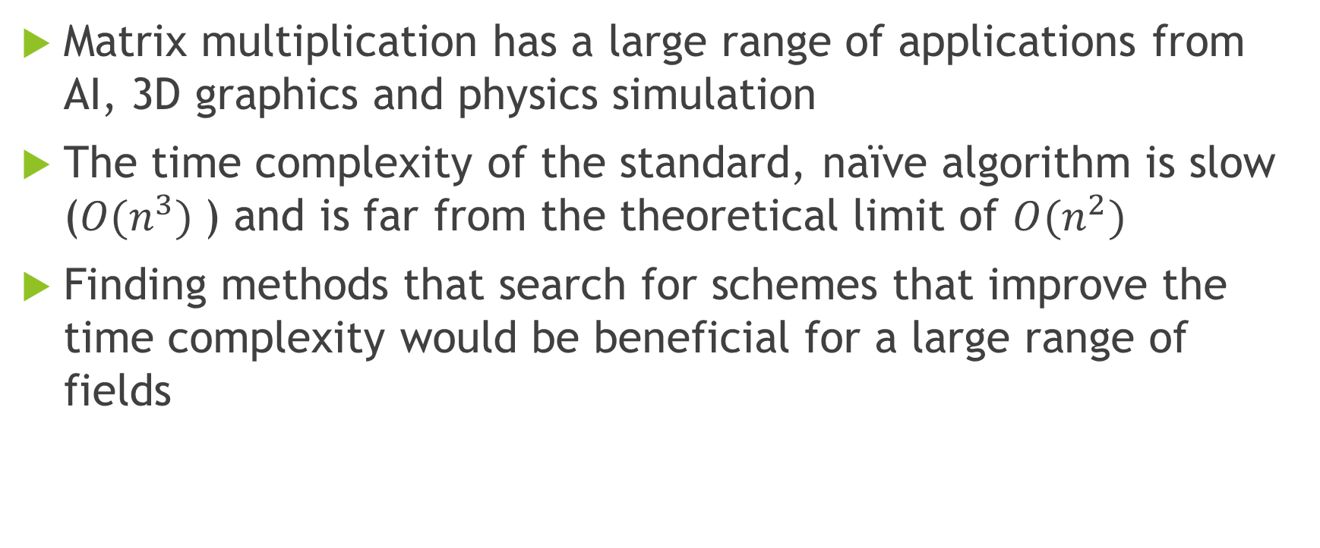
Motivation
Matrix multiplication has a large range of applications from AI, 3D graphics and physics simulation
The time complexity of the standard, naïve algorithm is slow ($O(n^{3})$) and is far from the theoretical limit of $O(n^{2})$
Finding methods that search for schemes that improve the time complexity would be beneficial for a large range of fields

Slide 3
Project Methodology
I have used Agile to implement features.
After experimenting with existing code. I then went a made changes to see how that affected the performance
All my code can be found on GitHub here: https://github.com/JacobAdams101/MatrixMultiplicationProject

Slide 4
Background Information

Slide 5
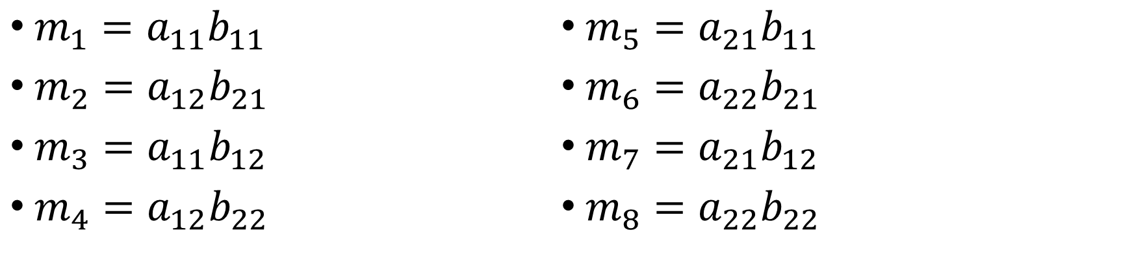
Representing Matrix Multiplication as a Multiplication Scheme: 2x2 Example
$$\left[\begin{matrix}a_{11} & a_{12} \\ a_{21} & a_{22}\end{matrix}\right]\left[\begin{matrix}b_{11} & b_{12} \\ b_{21} & b_{22}\end{matrix}\right]=\left[\begin{matrix}a_{11}b_{11}+a_{12}b_{21} & a_{11}b_{12}+a_{12}b_{22} \\ a_{21}b_{11}+a_{22}b_{21} & a_{21}b_{12}+a_{22}b_{22}\end{matrix}\right]$$
${m_{1}=a}_{11}b_{11}$
${m_{2}=a}_{12}b_{21}$
${m_{3}=a}_{11}b_{12}$
${m_{4}=a}_{12}b_{22}$
${m_{5}=a}_{21}b_{11}$
${m_{6}=a}_{22}b_{21}$
${m_{7}=a}_{21}b_{12}$
${m_{8}=a}_{22}b_{22}$
$$\left[\begin{matrix}a_{11} & a_{12} \\ a_{21} & a_{22}\end{matrix}\right]\left[\begin{matrix}b_{11} & b_{12} \\ b_{21} & b_{22}\end{matrix}\right]=\left[\begin{matrix}m_{1}+m_{2} & m_{3}+m_{4} \\ m_{5}+m_{6} & m_{7}+m_{8}\end{matrix}\right]$$

Slide 6
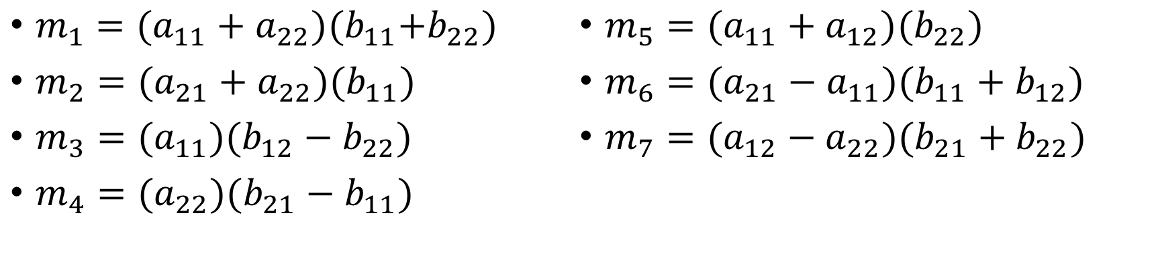
Strassen’s Algorithm
${m_{1}=(a}_{11}+a_{22}){(b}_{11}+b_{22})$
${m_{2}=(a}_{21}+a_{22})(b_{11})$
${m_{3}=(a}_{11})(b_{12}−b_{22})$
${m_{4}=(a}_{22})(b_{21}−b_{11})$
${m_{5}=(a}_{11}+a_{12})(b_{22})$
${m_{6}=(a}_{21}−a_{11})(b_{11}+b_{12})$
${m_{7}=(a}_{12}−a_{22})(b_{21}+b_{22})$
${c_{1}=m}_{1}+m_{4}−m_{5}+m_{7}$
${c_{2}=m}_{3}+m_{5}$
${c_{3}=m}_{2}+m_{4}$
${c_{4}=m}_{1}−m_{2}+m_{3}+m_{6}$
$$\left[\begin{matrix}a_{11} & a_{12} \\ a_{21} & a_{22}\end{matrix}\right]\left[\begin{matrix}b_{11} & b_{12} \\ b_{21} & b_{22}\end{matrix}\right]=\left[\begin{matrix}c_{1} & c_{2} \\ c_{3} & c_{4}\end{matrix}\right]$$

Slide 7
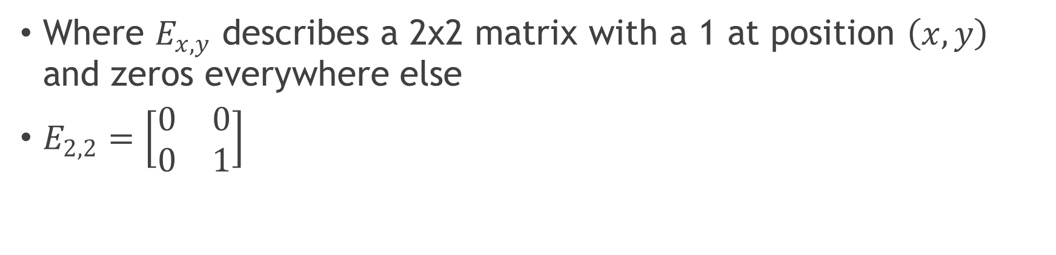
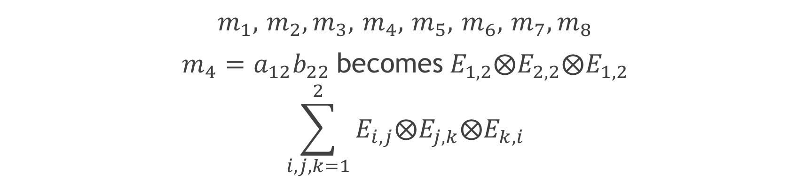
Tensor Representation
$m_{1},$ $m_{2},m_{3},$ $m_{4},$ $m_{5},$ $m_{6},$ $m_{7},m_{8}$
${m_{4}=a}_{12}b_{22}$becomes $E_{1,2}⨂E_{2,2}⨂E_{1,2}$
$$\sum_{i,j,k=1}^{2}{E_{i,j}⨂E_{j,k}⨂E_{k,i}}$$
Where $E_{x,y}$ describes a 2x2 matrix with a 1 at position $\left(x,y\right)$ and zeros everywhere else
$E_{2,2}=\left[\begin{matrix}0 & 0 \\ 0 & 1\end{matrix}\right]$

Slide 8
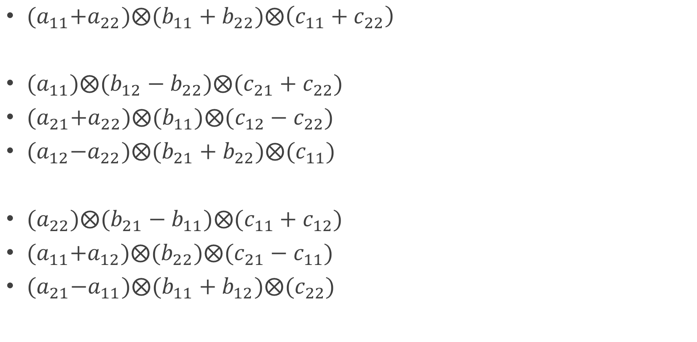
Strassen’s Algorithm as a Tensor
${ (a}_{11}+a_{22}){⨂(b}_{11}+b_{22})⨂\left(c_{11}+c_{22}\right)$
${ (a}_{11})⨂(b_{12}−b_{22})⨂(c_{21}+c_{22})$
${ (a}_{21}+a_{22})⨂(b_{11})⨂(c_{12}−c_{22})$
${ (a}_{12}−a_{22})⨂(b_{21}+b_{22})⨂(c_{11})$
${ (a}_{22})⨂(b_{21}−b_{11})⨂(c_{11}+c_{12})$
${ (a}_{11}+a_{12})⨂(b_{22})⨂(c_{21}−c_{11})$
${ (a}_{21}−a_{11})⨂(b_{11}+b_{12})⨂(c_{22})$

Slide 9
Goal
We want to describe an algorithm that can start from any size standard multiplication scheme and find better schemes (Such as Strassen’s on the 2x2)
We need to define operations to rearrange these tensors to reduce the size of the set
We will define 2 operations: the flip and the reduction

Slide 10
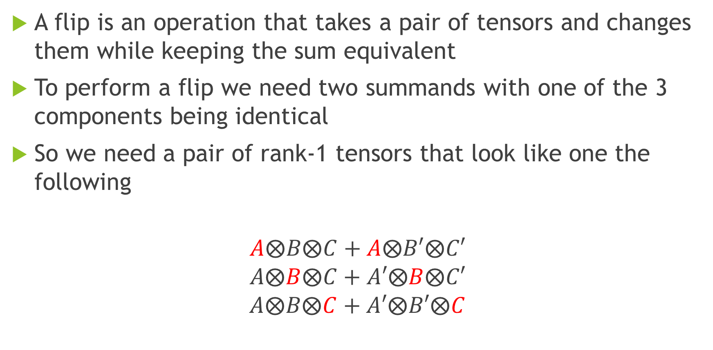
Defining a Flip
A flip is an operation that takes a pair of tensors and changes them while keeping the sum equivalent
To perform a flip we need two summands with one of the 3 components being identical
So we need a pair of rank-1 tensors that look like one the following
$$A⨂B⨂C+A⨂B′⨂C′$$
$$A⨂B⨂C+A′⨂B⨂C′$$
$$A⨂B⨂C+A′⨂B′⨂C$$

Slide 11
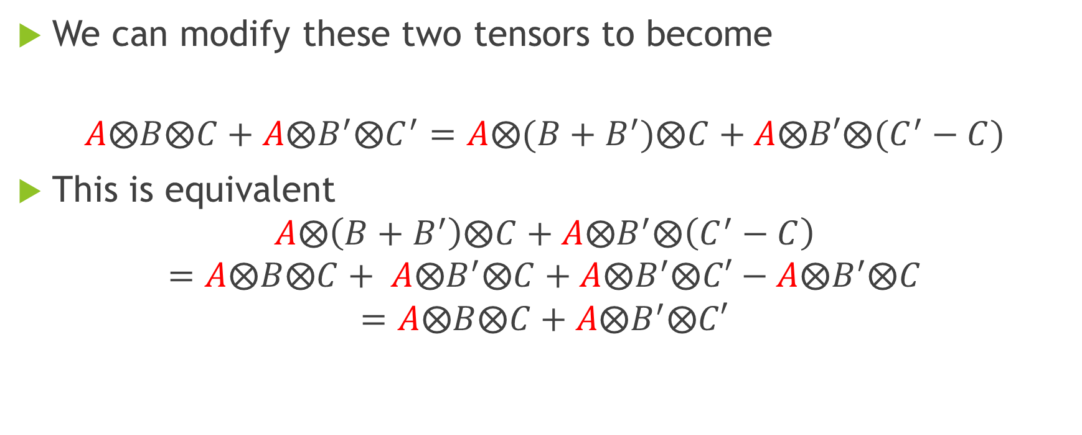
Defining a Flip
We can modify these two tensors to become
$$A⨂B⨂C+A⨂B^{′}⨂C^{′}=A⨂(B+B^{′})⨂C+A⨂B′⨂(C^{′}−C)$$
This is equivalent
$$A⨂\left(B+B^{′}\right)⨂C+A⨂B^{′}⨂\left(C^{′}−C\right)=A⨂B⨂C+ A⨂B^{′}⨂C+A⨂B^{′}⨂C′−A⨂B^{′}⨂C=A⨂B⨂C+A⨂B^{′}⨂C′$$

Slide 12
Defining a Reduction
We want to be able to describe a procedure that can make our set of rank-1 tensors smaller.
At a high level we look for linear dependencies amongst subsets of the rank-1 tensors then rebuild our set
Reductions let us make our set of tensors smaller leading to faster algorithms

Slide 13
The Flip Graph
We define a graph where each vertex is a valid representation of a multiplication scheme
We add directed edges to the graph for flips and reductions
It’s then possible to explore this graph using a random walk
Flip
Flip
Reduction
Reduction
Flip
Flip
Flip
Flip
Flip

Slide 14
Research into Improved Ways to Explore/Modify the Flip Graph

Slide 15
Problems and Potential Improvements
This graph is very large and becomes unfeasible to explore all of it for multiplication schemes of larger sized matrices
Can we reduce the size of what we explore somehow?

Slide 16
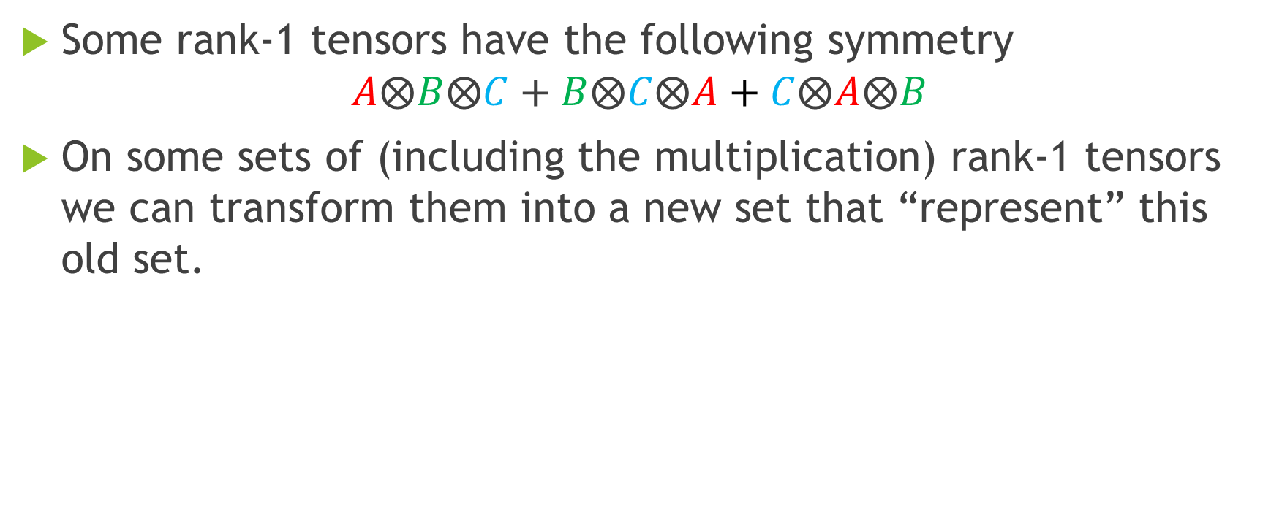
Using the Symmetry of the Tensors
Some rank-1 tensors have the following symmetry
$$A⨂B⨂C+B⨂C⨂A+C⨂A⨂B$$
On some sets of (including the multiplication) rank-1 tensors we can transform them into a new set that “represent” this old set.

Slide 17
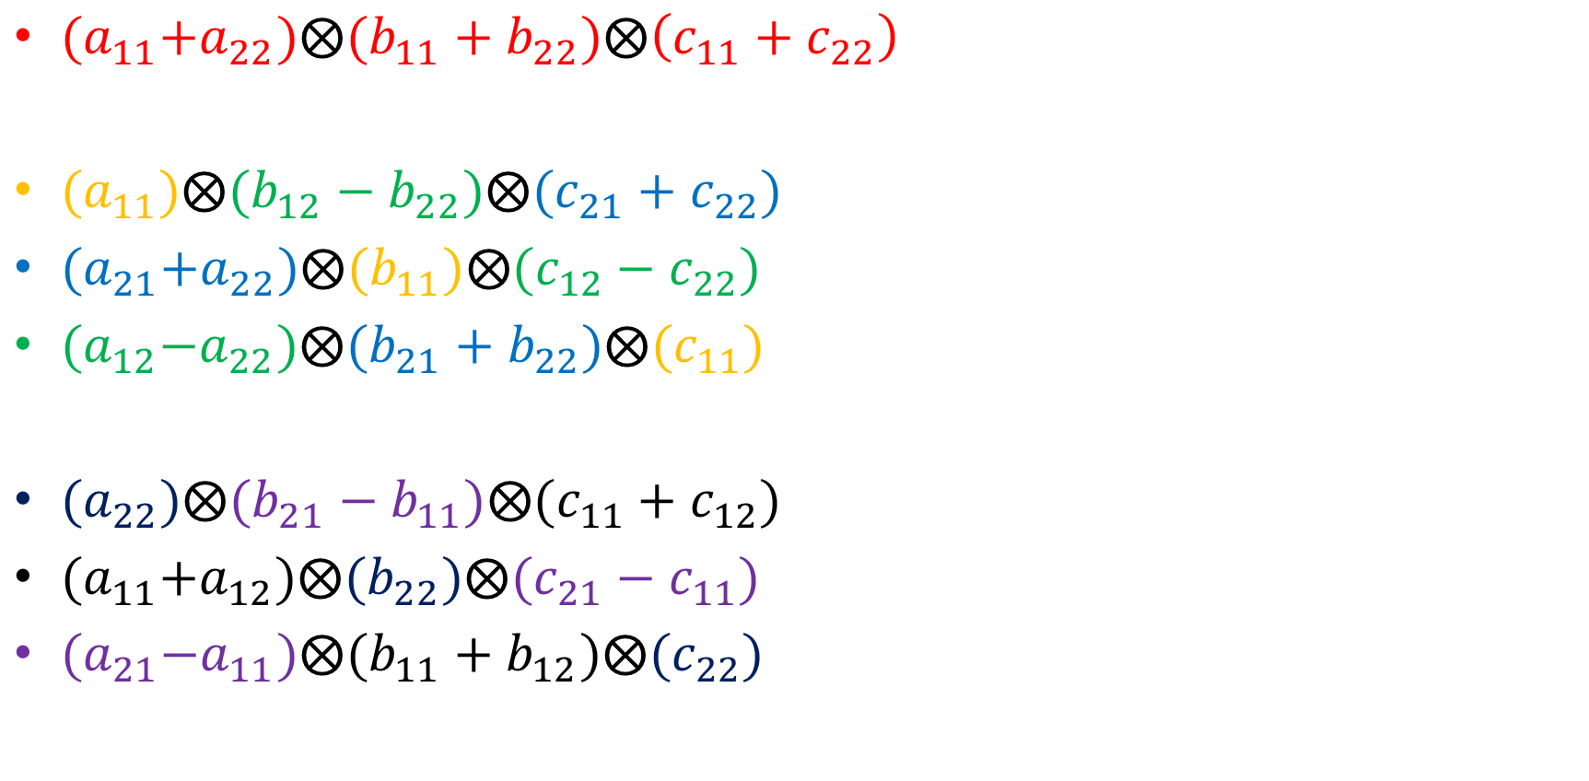
Example of Symmetry for Strassen’s
${ (a}_{11}+a_{22}){⨂(b}_{11}+b_{22})⨂\left(c_{11}+c_{22}\right)$
${ (a}_{11})⨂(b_{12}−b_{22})⨂(c_{21}+c_{22})$
${ (a}_{21}+a_{22})⨂(b_{11})⨂(c_{12}−c_{22})$
${ (a}_{12}−a_{22})⨂(b_{21}+b_{22})⨂(c_{11})$
${ (a}_{22})⨂(b_{21}−b_{11})⨂(c_{11}+c_{12})$
${ (a}_{11}+a_{12})⨂(b_{22})⨂(c_{21}−c_{11})$
${ (a}_{21}−a_{11})⨂(b_{11}+b_{12})⨂(c_{22})$

Slide 18
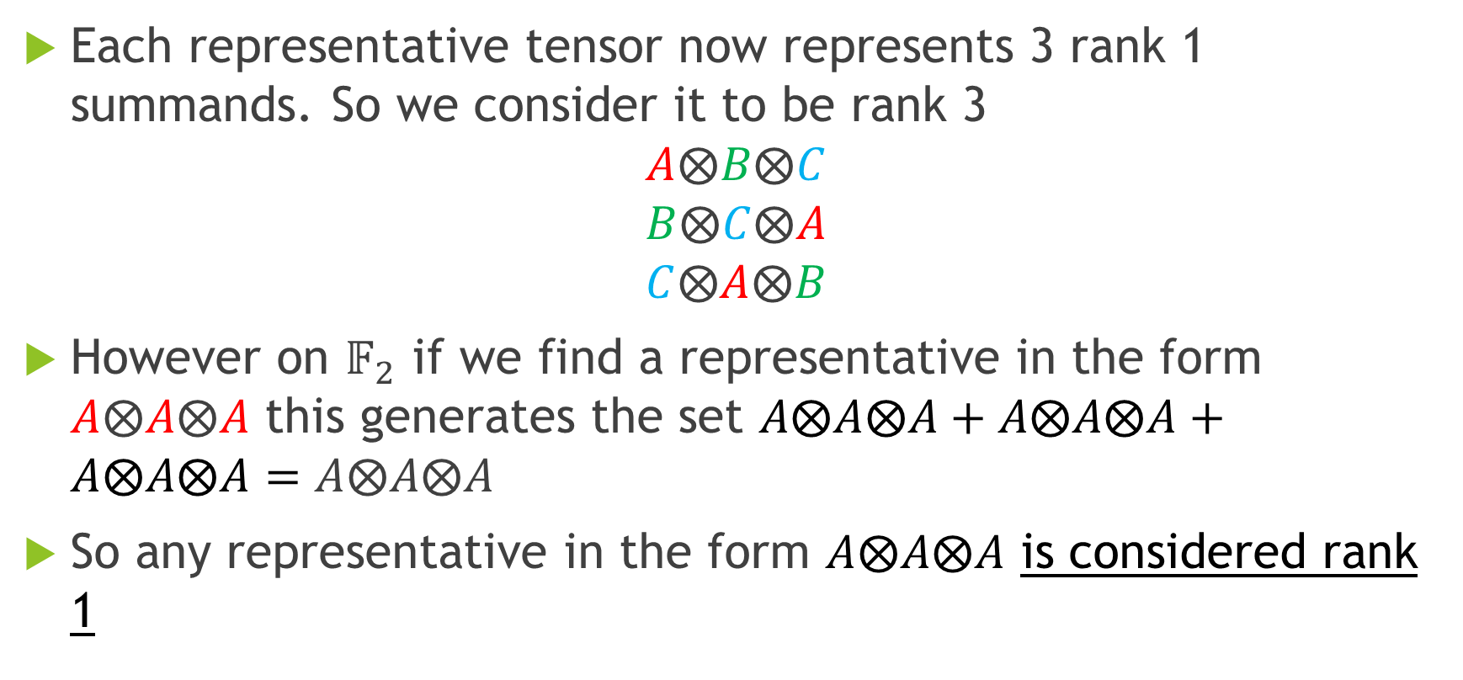
Thinking about the Rank
Each representative tensor now represents 3 rank 1 summands. So we consider it to be rank 3
$$A⨂B⨂C$$
$$B⨂C⨂A$$
$$C⨂A⨂B$$
However on $𝔽_{2}$ if we find a representative in the form $A⨂A⨂A$ this generates the set $A⨂A⨂A+A⨂A⨂A+A⨂A⨂A=A⨂A⨂A$
So any representative in the form $A⨂A⨂A$ is considered rank 1

Slide 19
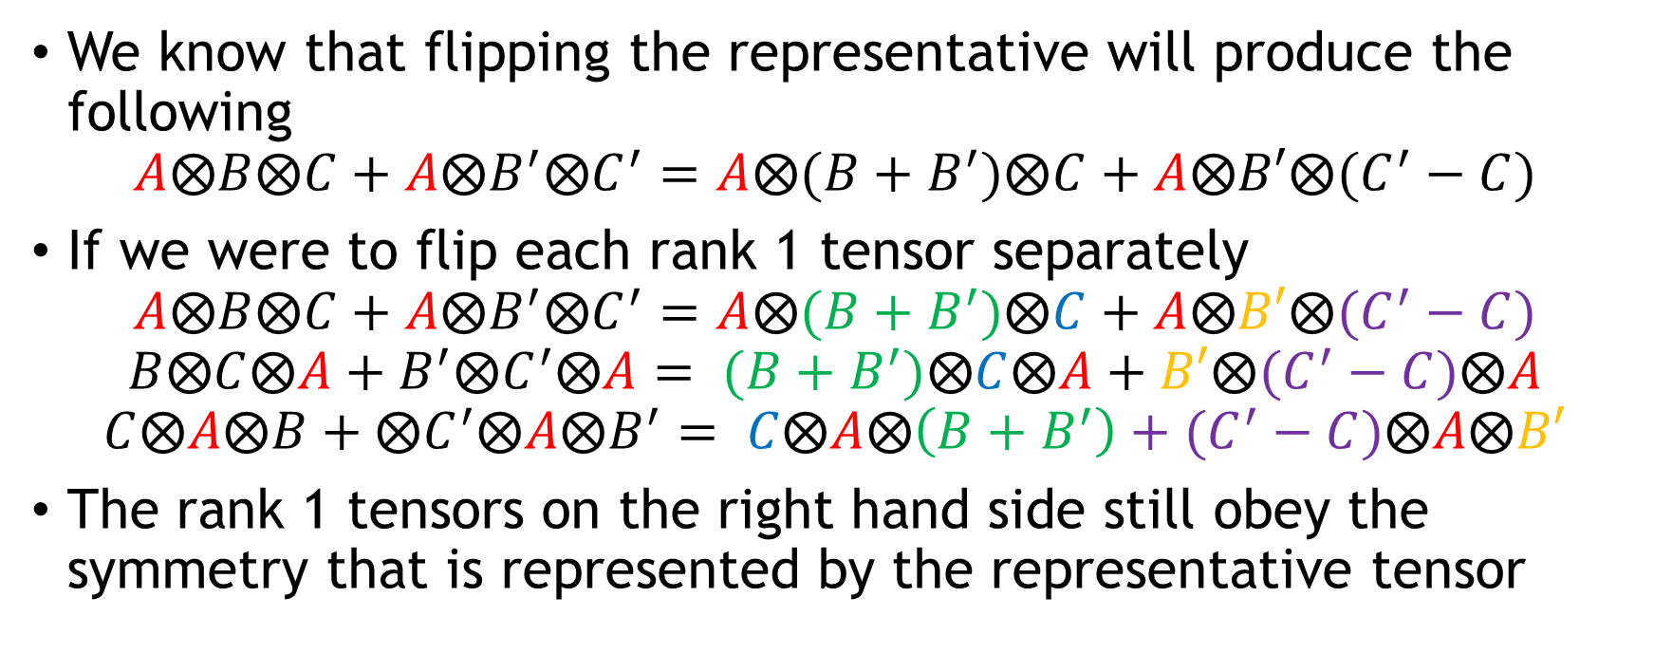
Flips Still Yield Correct Multiplication Schemes on the Set of Representatives
We know that flipping the representative will produce the following
$$A⨂B⨂C+A⨂B^{′}⨂C^{′}=A⨂(B+B^{′})⨂C+A⨂B′⨂(C^{′}−C)$$
If we were to flip each rank 1 tensor separately
$$A⨂B⨂C+A⨂B^{′}⨂C^{′}=A⨂(B+B^{′})⨂C+A⨂B′⨂(C^{′}−C)$$
$$B⨂C⨂A+B^{′}⨂C^{′}⨂A= (B+B^{′})⨂C⨂A+B′⨂(C^{′}−C)⨂A$$
$$C⨂A⨂B+⨂C^{′}⨂A⨂B^{′}= C⨂A⨂\left(B+B^{′}\right)+(C^{′}−C)⨂A⨂B′$$
The rank 1 tensors on the right hand side still obey the symmetry that is represented by the representative tensor

Slide 20
Reductions Still Yield Correct Multiplication Schemes on the Set of Representatives
Reductions work very much the same way as flips.
It’s worth mentioning that a reduction of representatives is the same as 3 reductions on the normal set of tensors

Slide 21
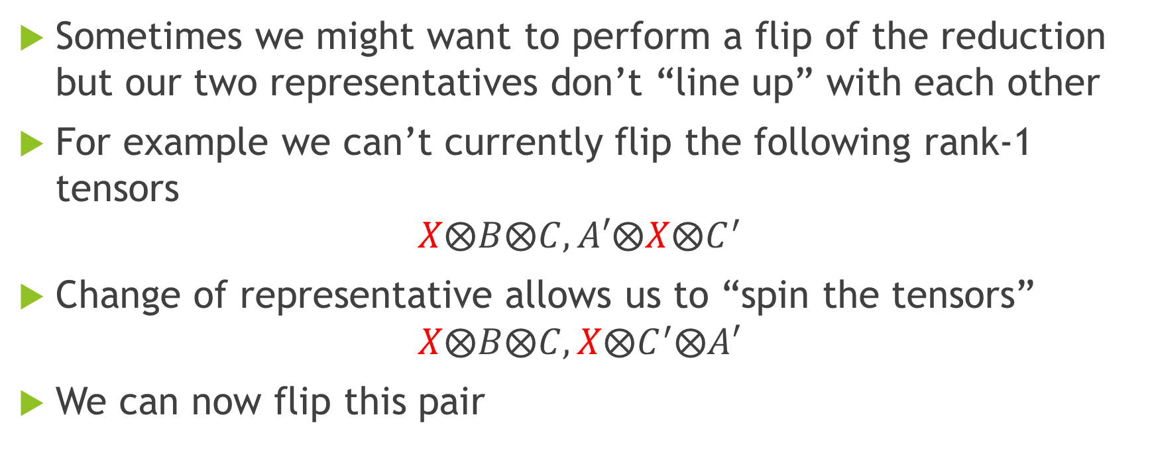
Introducing a New Operation
Sometimes we might want to perform a flip of the reduction but our two representatives don’t “line up” with each other
For example we can’t currently flip the following rank-1 tensors
$$X⨂B⨂C, A′⨂X⨂C^{′}$$
Change of representative allows us to “spin the tensors”
$$X⨂B⨂C, X⨂C^{′}⨂A′$$
We can now flip this pair

Slide 22
Pseudocode for Modified Algorithm
N ← INPUT_MATRIX_SIZE
S ← GET_NIAVE_MULTIPLICATION_SCHEME(N,N,N)
R ← REDUCE_TO_SYMMETRY(S) //Resulting set of representatives
Step ← 0
LOOP
IF any neighbours (through a flip and potentially a change of representative) are reducible THEN
REDUCE(R)
ELSE
MAKE_RANDOM_FLIP(R)
ENDIF
IF Step > LOOK_FOR_SINGLETONS_AT THEN
FIND_SINGLETONS(R)
ENDIF
Step ← Step + 1
NEXT

Slide 23
The Data
I ran approximately 250 runs of the old and new algorithm up to 1000000 steps
Each time a run reached a new minimum rank I recorded the number of steps and the time it took to reach that rank.
I did this for different sized matrix multiplication schemes

Slide 24
23
25
23
24
27
Time (s)
25
Time (s)
26
30
27
33
Sorted Runs
Sorted Runs
23
25
23
27
24
25
26
30
Steps
Steps
27
33
Sorted Runs
Sorted Runs

Slide 25
52
51
50
49
53
54
55
56
57
49
51
54
57
63
58
60
59
60
61
62
63
66
Time (s)
Time (s)
64
69
72
52
51
50
49
Sorted Runs
Sorted Runs
53
54
55
49
51
57
56
54
57
60
63
58
66
60
59
61
62
63
69
Steps
64
Steps
72
Sorted Runs
Sorted Runs

Slide 26
101
103
103
105
120
108
108
111
114
117
111
114
117
120
123
105
126
123
129
132
126
Time (s)
Time (s)
129
135
132
135
Sorted Runs
Sorted Runs
103
105
101
103
108
111
114
117
120
123
108
111
114
117
120
105
126
129
123
126
132
129
Steps
135
Steps
132
135
Sorted Runs
Sorted Runs

Slide 27
Evaluation

Slide 28
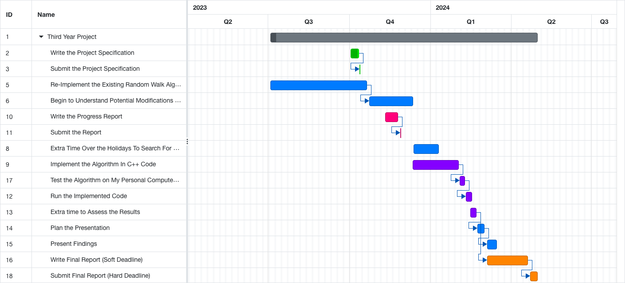
Project Timeline Evaluation
✔
✔
✔
✔
✔
✔
✔
✔
✔
✔
✔
✔

Slide 29
Positives
We can find schemes that match records (e.g. 23 for (3,3,3) )
Despite the higher starting rank, for larger matrices, the modified algorithm “catches up”
For larger matrices and short runs, this algorithm appears to be successful at finding smaller multiplication schemes
This method is compatible with and seems to benefit from other recent improvements such as the Plus Transition and Edge Constraints

Slide 30
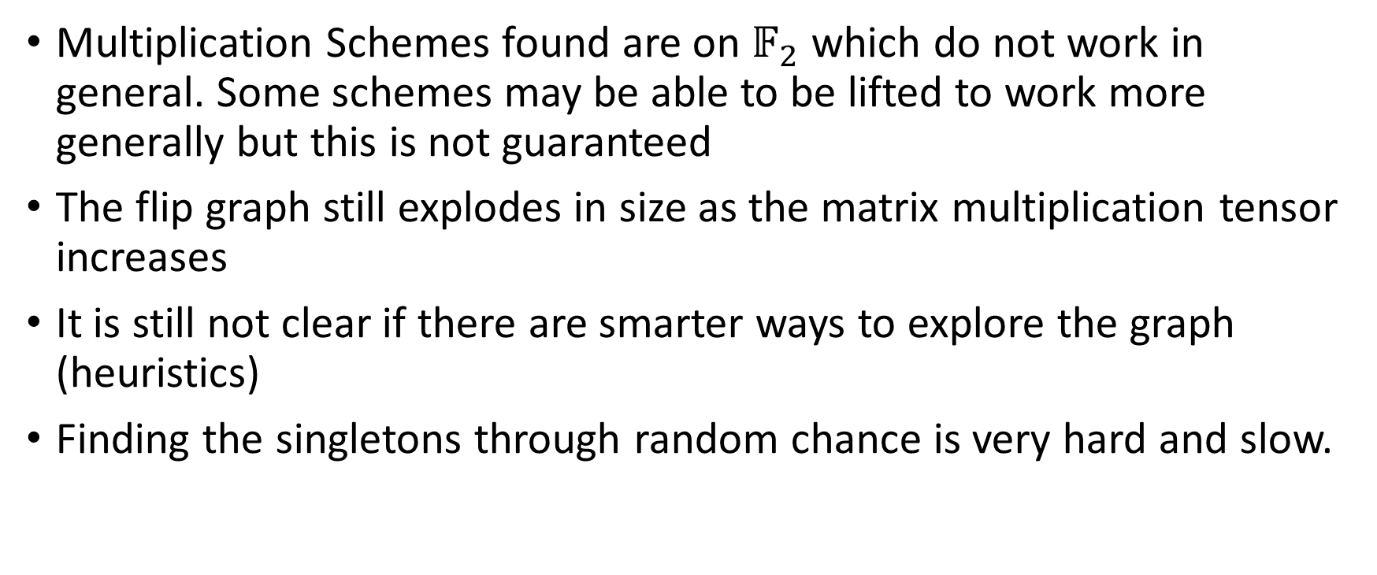
Limitations
Multiplication Schemes found are on $𝔽_{2}$ which do not work in general. Some schemes may be able to be lifted to work more generally but this is not guaranteed
The flip graph still explodes in size as the matrix multiplication tensor increases
It is still not clear if there are smarter ways to explore the graph (heuristics)
Finding the singletons through random chance is very hard and slow.

Slide 31
Future Development
It would be interesting to try and explore larger flip graphs with this method
To mitigate the problem of finding singletons it may be beneficial to adopt a hybrid method where after a certain number of steps the symmetry is expanded out and the run continues in a more normal way
Other symmetries also exist some have much larger orbits so may lead to faster speedups

Slide 32
Live Demo & Q&A

Slide 33
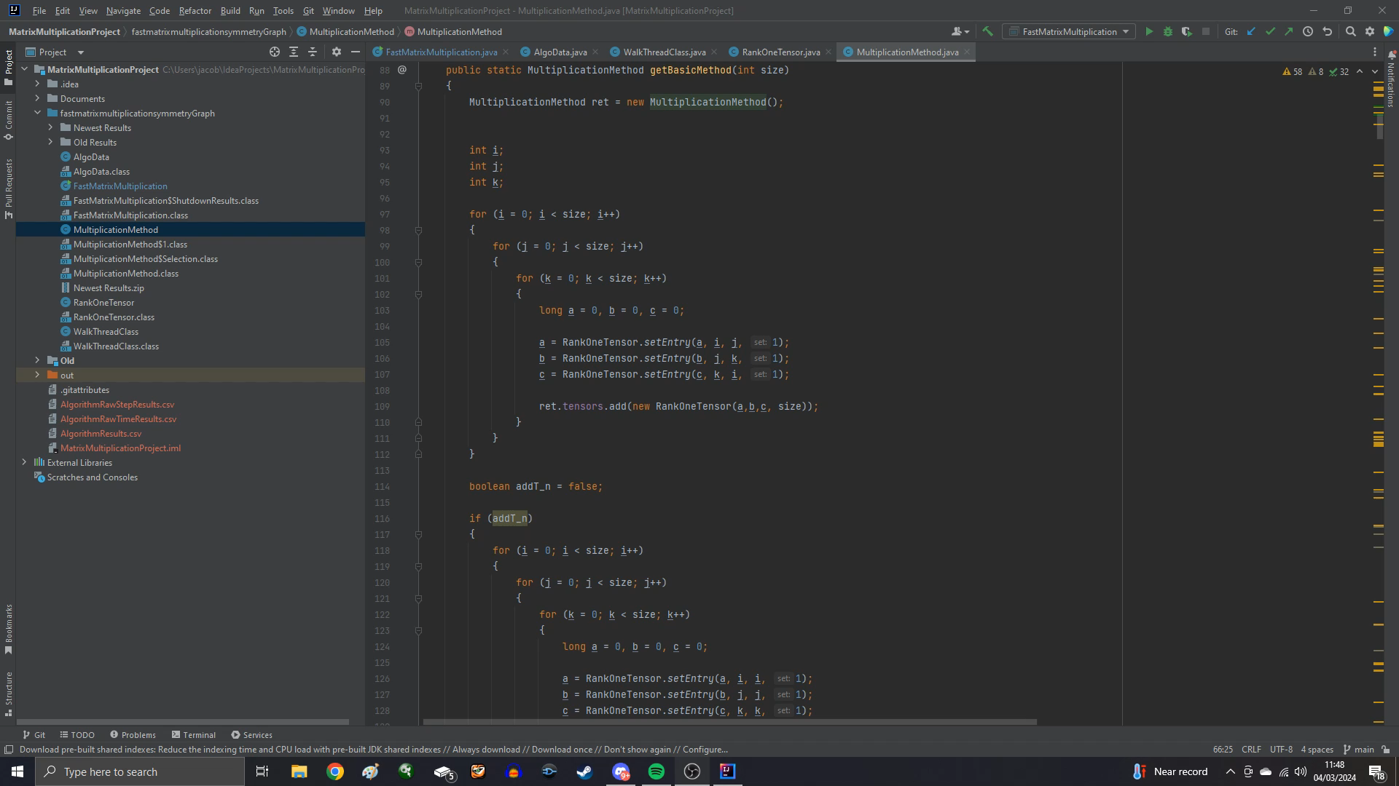

Slide 34
References
https://arxiv.org/pdf/2212.01175.pdf
https://arxiv.org/abs/1610.08364
https://arxiv.org/abs/1801.00843
https://arxiv.org/abs/2312.16960

Slide 35
Finding Fast Matrix Multiplication with Symmetry
Jacob Adams

